Slide 1

GitOps workshop
Andrea Giardini
Consultant / Trainer in the field of Cloud Technologies Infra Engineer @ Overstory B.V.
Website: https://andreagiardini.com
Twitter: @GiardiniAndrea

Slide 2
About Me
I come from 🇮🇹, but I live in 🇳🇱
Consultant / Trainer in the field of Cloud Technologies @ Freelance Infra Engineer @ Overstory B.V.
Passionate about Kubernetes, Containers and Microservices
I often talk about Infrastructure, Automation and DRY

Slide 3
Agenda
Introduzione a GitOps: Cosa, come, perche'?
Strumenti disponibili per GitOps e Kubernetes
ArgoCD: installazione e funzionalita' principali
Organizzare il nostro repository GitOps
La prima pipeline
Suggerimenti e best practices
Q&A

Slide 4
GitOps

Slide 5
Principles of GitOps
> #1. The entire system described declaratively.
Kubernetes is just one example of many modern cloud native tools that are “declarative” and that can be treated as code. Declarative means that configuration is guaranteed by a set of facts instead of by a set of instructions. With your application’s declarations versioned in Git, you have a single source of truth. Your apps can then be easily deployed and rolled back to and from Kubernetes. And even more importantly, when disaster strikes, your cluster’s infrastructure can also be dependably and quickly reproduced.
Configuration is guaranteed by a set of facts
Configuration is guaranteed by a set of instructions
Source: Weaveworks
Notes:
Think it like the difference between imperative and declarative programming
example, “there are ten redis servers”, rather than “start ten redis servers, and tell me if it worked or not”.

Slide 6
Principles of GitOps
> #2. The canonical desired system state versioned in Git.
With the declaration of your system stored in a version control system, and serving as your canonical source of truth, you have a single place from which everything is derived and driven. This trivializes rollbacks; where you can use a `Git revert` to go back to your previous application state. With Git’s excellent security guarantees, you can also use your SSH key to sign commits that enforce strong security guarantees about the authorship and provenance of your code.
Single place to store configuration and manifests
Configuration files and manifests are spread around many repos. Dependencies are unclear
Source: Weaveworks

Slide 7
Principles of GitOps
> #3. Approved changes that can be automatically applied to the system.
Once you have the declared state kept in Git, the next step is to allow any changes to that state to be automatically applied to your system. What's significant about this is that you don't need cluster credentials to make a change to your system. With GitOps, there is a segregated environment of which the state definition lives outside. This allows you to separate what you do and how you're going to do it.
Changes are applied to our system by an automated process
Manual intervention is required whenever we need to deploy a new change
Source: Weaveworks

Slide 8
Principles of GitOps
> #4. Software agents to ensure correctness and alert on divergence.
Once the state of your system is declared and kept under version control, software agents can inform you whenever reality doesn’t match your expectations. The use of agents also ensures that your entire system is self-healing. And by self-healing, we don’t just mean when nodes or pods fail—those are handled by Kubernetes—but in a broader sense, like in the case of human error. In this case, software agents act as the feedback and control loop for your operations.
Infrastructure convergence is guaranteed by software
Configuration drifts are difficult to detect and fix
Source: Weaveworks

Slide 9
Tools for GitOps

Slide 10


ArgoCD & FluxCD

Slide 11
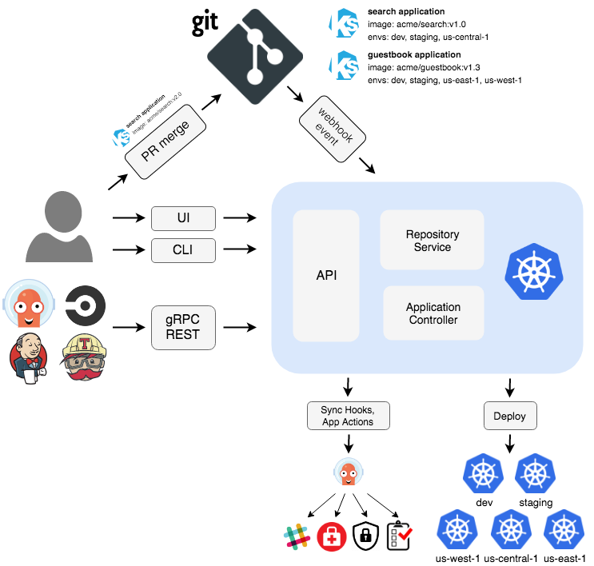

Slide 12
ArgoCD - Core concepts
Tool
Application
Live State
Software used to generate manifests
Helm
Kustomize
etc...
Group of Kubernetes resources
Deployments
Services
Configmaps
etc...
Live state of the app
-> what is deployed
Target State
Desired state of the app
-> what should be deployed

Slide 13
ArgoCD - Core concepts
Refresh
Sync
Compare the latest code in Git with the live state
The process of making an application move to its target state

Slide 14
Getting Started

Slide 15
Ready … Set … Go!
We are going to need a git repository to store the configuration of our infrastructure:
-> Head to https://github.com/AndreaGiardini/GitOps-workshop and fork it
During the workshop, this fork will be used to store the configuration of our application
Notes:
Mention Discord polls

Slide 16

Kustomize
Kustomize is a CLI for managing k8s style objects in a declarative way.
It traverses Kubernetes manifests to add, remove or update configuration options
Kustomize builds k8s manifests and prints them to stdout. We can then forward the output to kubectl apply.

Slide 17
Example: Kustomize
Use case
Same application on staging and production with different replicas
hello-world
├── base
│ ├── deployment.yaml
│ └── kustomization.yaml
1. Create a Base
Directory with a set of k8s resources and a kustomization.yaml file. A base can be local or remote
└── overlays
├── production
│
│
└── staging
│ ├── kustomization.yaml
│ └── replica_count.yaml
├── kustomization.yaml
└── replica_count.yaml
2. Create a new overlay for every environment
An overlay adds customizations on top of other bases. All resources are defined in a kustomization.yaml file
3. Define the differences in the overlays folders
Overlays are applied on top of the bases like a patch on a git repository.

Slide 18
Example: Kustomize
namespace: argocd
bases: - github.com/argoproj/argo-cd/[...]
resources: - resources/namespace.yaml
Repository file: argocd_deploy/kustomization.yaml
Remote base - from ArgoCD repository
Local resource - to create the namespace where we will install ArgoCD
Namespace - adds all resources to the specified namespace

Slide 19
Installing ArgoCD
The Argo stack is composed by a multitude of different, independent projects. Each software provides a different functionality and each one can be installed only if we need said functionality.
ArgoCD
ArgoCD Notifications
Argo Workflows
Argo Events
Argo Rollouts
We will pause here for a couple of minutes
Open the README.md file in the repository and follow the instructions in:
0. Setup
By the end of this section, you should be able to:
Access the ArgoCD interface in your web browser

Slide 20
ArgoCD Interface

Slide 21
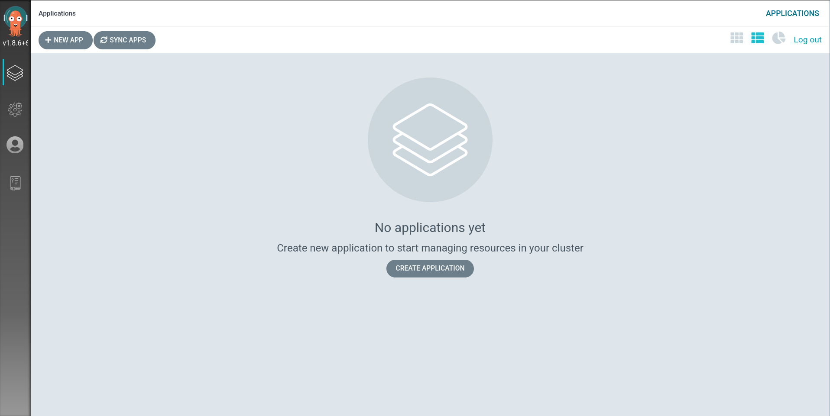
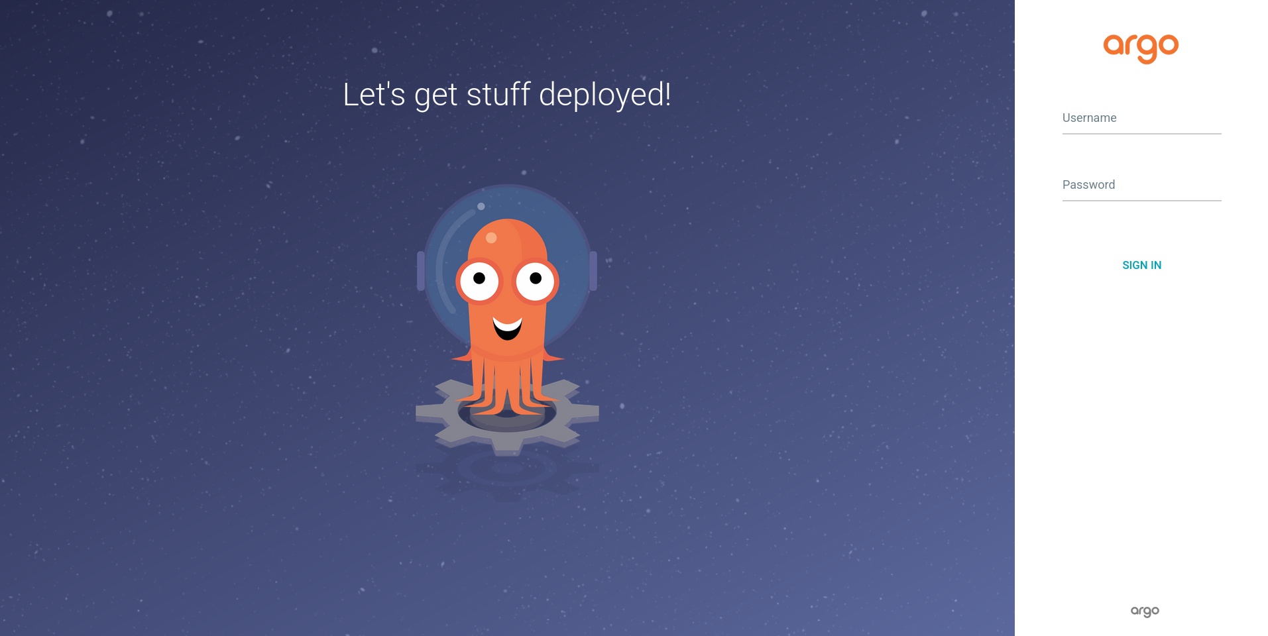
ArgoCD Interface

Slide 22
Our first Tool and Application
What you see is a fresh installation of ArgoCD, with no application installed and nothing to do (yet)
We need to define Tools and Applications so that ArgoCD can manage applications for us:
-> Our first Tool : Kustomize -> Our first Application : ArgoCD
In the previous section, we used Kustomize to install ArgoCD manually.
-> Let's automate this process by letting ArgoCD manage itself

Slide 23
Tools: Kustomize, Helm, Jsonnet...
ArgoCD bundles in its image some of the tools mentioned…
However, these tools might not match the version we need!
Being an un-opinionated software, ArgoCD allows us to download and configure all the custom tooling that we need, in the version that we need.
-> Install kustomize -> Add application

Slide 24
Example: Kustomize
namespace: argocd
bases: - github.com/argoproj/argo-cd/[...]
resources: - resources/namespace.yaml
Repository file: argocd_deploy/kustomization.yaml
patchesStrategicMerge:
- overlays/argocd-cm.yaml
Add a new key to an existing configmap defined in the base
apiVersion: v1 kind: ConfigMap metadata: name: argocd-cm Data: kustomize.version.v3.10.0: [...]
Repository file: argocd_deploy/overlays/argocd-cm.yaml

Slide 25
Manage ArgoCD with ArgoCD
In the next lab, we are going to:
The instance of ArgoCD that we just created is going to be managed by ArgoCD itself
From now on, we will trigger new deployments and synchronization just by pushing manifests to the git repository
We will pause here for a couple of minutes
Open the README.md file in the repository and follow the instructions in:
1. Argo with Argo
By the end of this section, you should be able to:
Have kustomize installed in ArgoCD
See ArgoCD installed in the list of applications

Slide 26
Application Definition

Slide 27
Application YAML
apiVersion: argoproj.io/v1alpha1 kind: Application metadata: name: argocd namespace: argocd
As everything else with ArgoCD, also monitored applications are defined as CRDs
spec: project: default source: repoURL: https://github.com/[...] targetRevision: HEAD path: argocd_deploy kustomize: version: v3.10.0
Application manifest definition
destination: server: https://kubernetes.default.svc namespace: argocd
Destination cluster
syncPolicy: automated: prune: true selfHeal: true allowEmpty: false
Sync Policy

Slide 28
Argo Upgrade
Let's test if our integration works well and if we configured ArgoCD to correctly manage itself
In the next lab you are going to upgrade ArgoCD within ArgoCD
By pushing a change to the git repository, ArgoCD will upgrade itself to the next version
We will pause here for a couple of minutes
Open the README.md file in the repository and follow the instructions in:
2. Argo Upgrade
By the end of this section, you should be able to:
See a new version of Argo in the top left corner of the web interface (v1.8.7)

Slide 29
Monitoring & Helm Charts

Slide 30
Monitoring YAML
apiVersion: argoproj.io/v1alpha1 kind: Application metadata: name: kube-prometheus-stack namespace: argocd
spec: project: default source: repoURL: https://github.com/[...] targetRevision: HEAD path: app_kube-prometheus-stack helm: valueFiles: - values.yaml
Let's spend some time talking about this section ->
Using Helm instead of Kustomize ->
destination: server: https://kubernetes.default.svc namespace: monitoring
syncPolicy: automated: prune: true selfHeal: true allowEmpty: false syncOptions: - CreateNamespace=true

Slide 31
Tracking & Deployment
-> HEAD tracking
ArgoCD tracks a specific branch (e.g. master)
FLEXIBLE
-> Tag tracking
ArgoCD tracks a git tag
-> Commit pinning
ArgoCD tracks a specific commit
RIGID

Slide 32
Monitoring
As soon as your ArgoCD deployment grows, you will want to monitor its status at all time. In the next lab we will:
See how we can use Helm charts with GitOps
Deploy a Prometheus stack in our cluster
A grafana dashboard will be automatically installed, reporting the status of ArgoCD
We will pause here for a couple of minutes
Open the README.md file in the repository and follow the instructions in:
3. Monitoring
By the end of this section, you should be able to:
Access the monitoring interface (Grafana)

Slide 33
Notifications

Slide 34
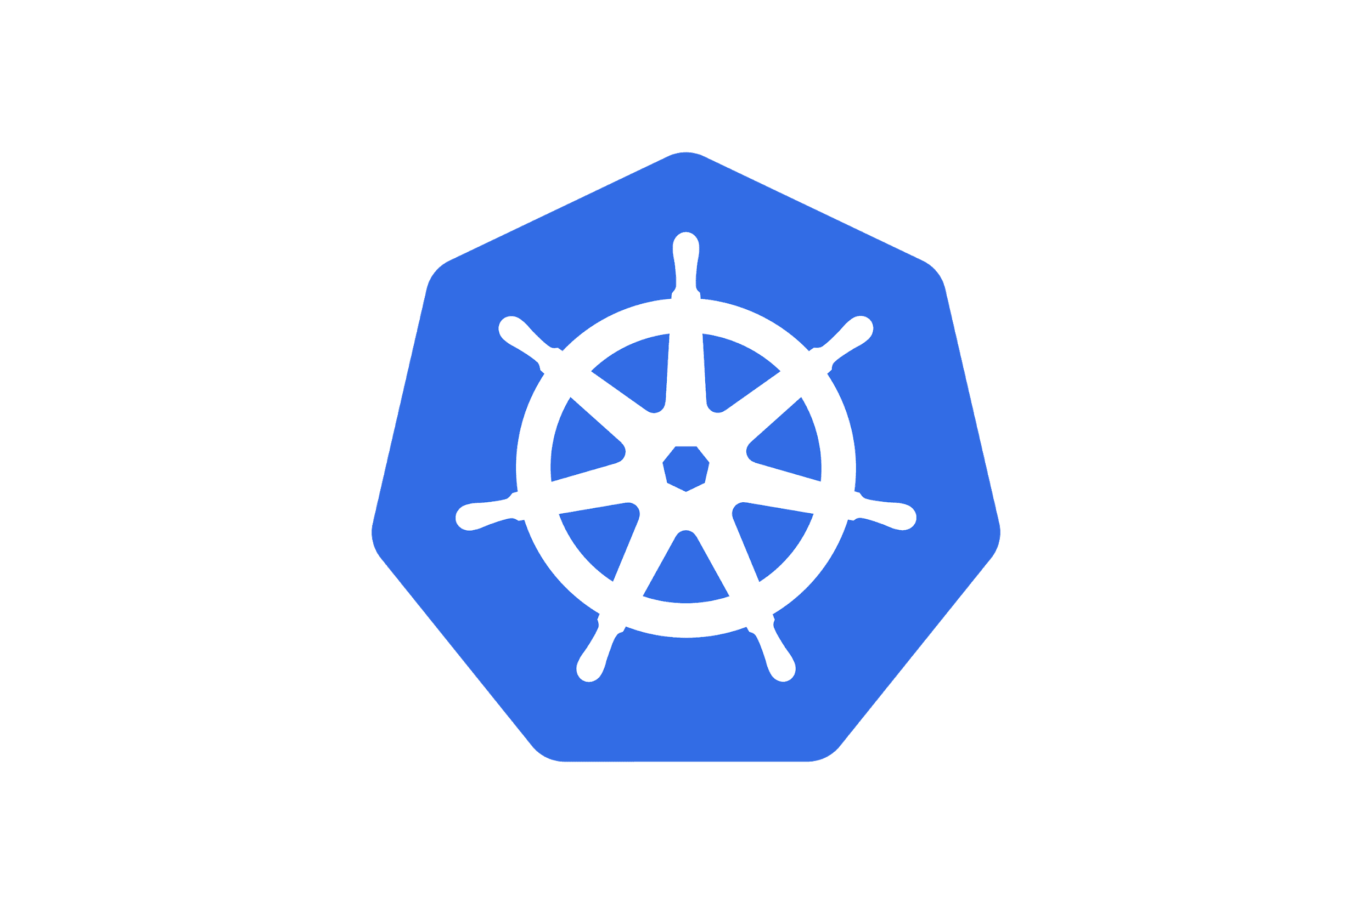




Notifications
If we are using ArgoCD in our environment, we might want to be notified whenever certain operations complete or in case of errors
-> ArgoCD Notifications
ArgoCD Notifications is not installed by default

Slide 35
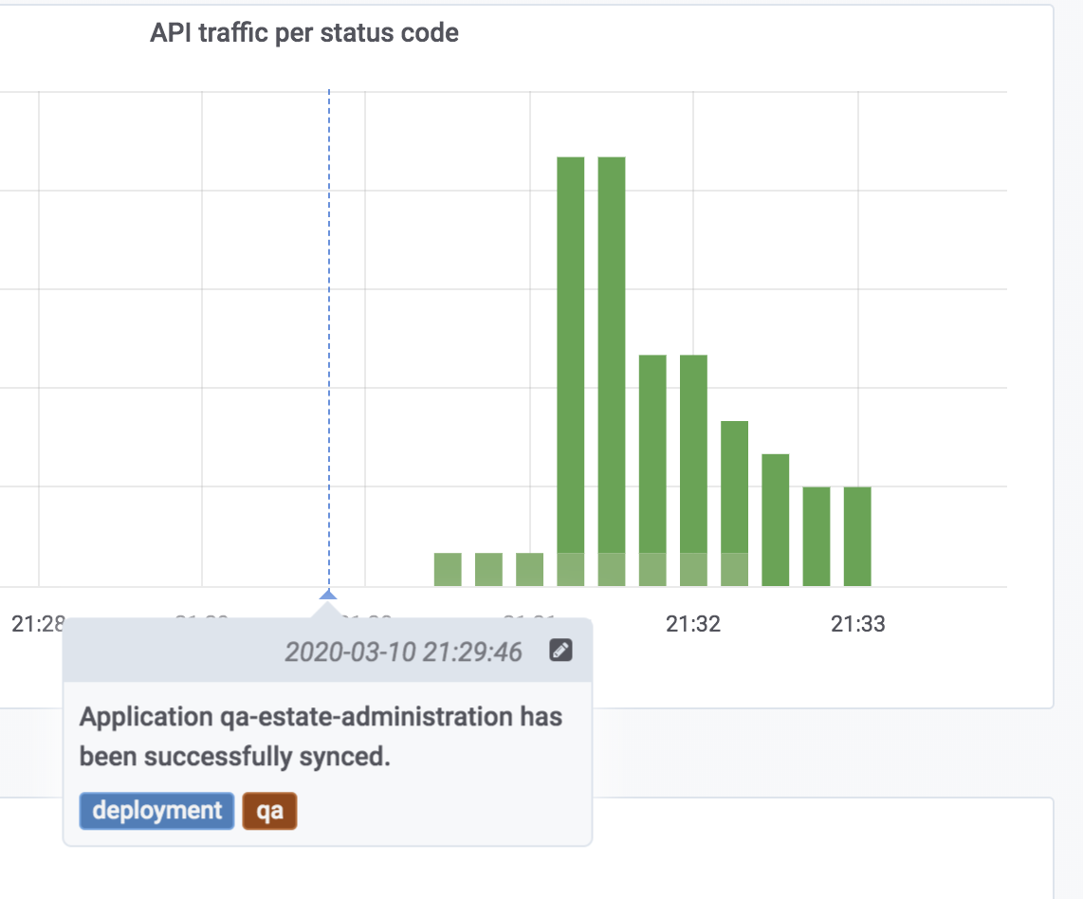
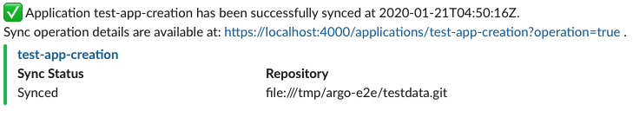
Notifications
A couple of interesting examples:
When a new version is deployed, we can ask Argo to add a new annotation to our Grafana dashboards
When a succeeds fails, we can let the team know on slack

Slide 36
Notifications
In the next lab, we are going to set up ArgoCD notifications:
Install ArgoCD Notifications
Define our notification settings
Link one application with the notification system
Let an application sync trigger a notification to our Discord channel
We will pause here for a couple of minutes
Open the README.md file in the repository and follow the instructions in:
4. Notifications
By the end of this section, you should be able to:
Send a notification in the Discord channel when an application sync completes successfully 🤞

Slide 37
Wrap Up!

Slide 38
Nice features about ArgoCD
No external db for state
Clear, declarative approach
Configuration drifts detection
Rollback = Git revert
Clear overview of cluster status
Hands-off approach

Slide 39
… Meh ... issues about ArgoCD
Best-practices ?
Very opinionated
Not a one-fits-all solution
Secrets management might get more complex

Slide 40
Gotchas and suggestions
Make sure the sync doesn't take too long
Start small, slowly increase the scope
Monitor your GitOps pipeline
Ensure external dependencies are pinned ...
… and have a strategy to update them
Hope for the best Prepare for the worst

Slide 41
The End
Website: andreagiardini.com

